Slide 1
Sailpoint IdentityIQ
Total Technology

Slide 2
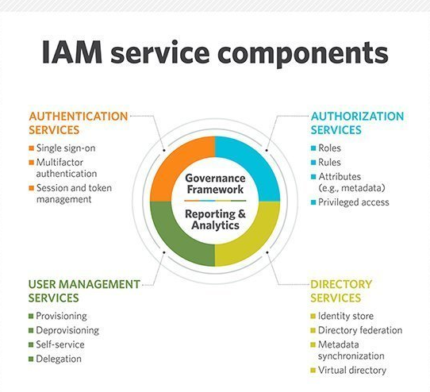
Identity & Access Management
What is Identity & Access Management?
A framework of policies and technologies for ensuring that the proper people in an enterprise have the appropriate access to technology resources.

Slide 3
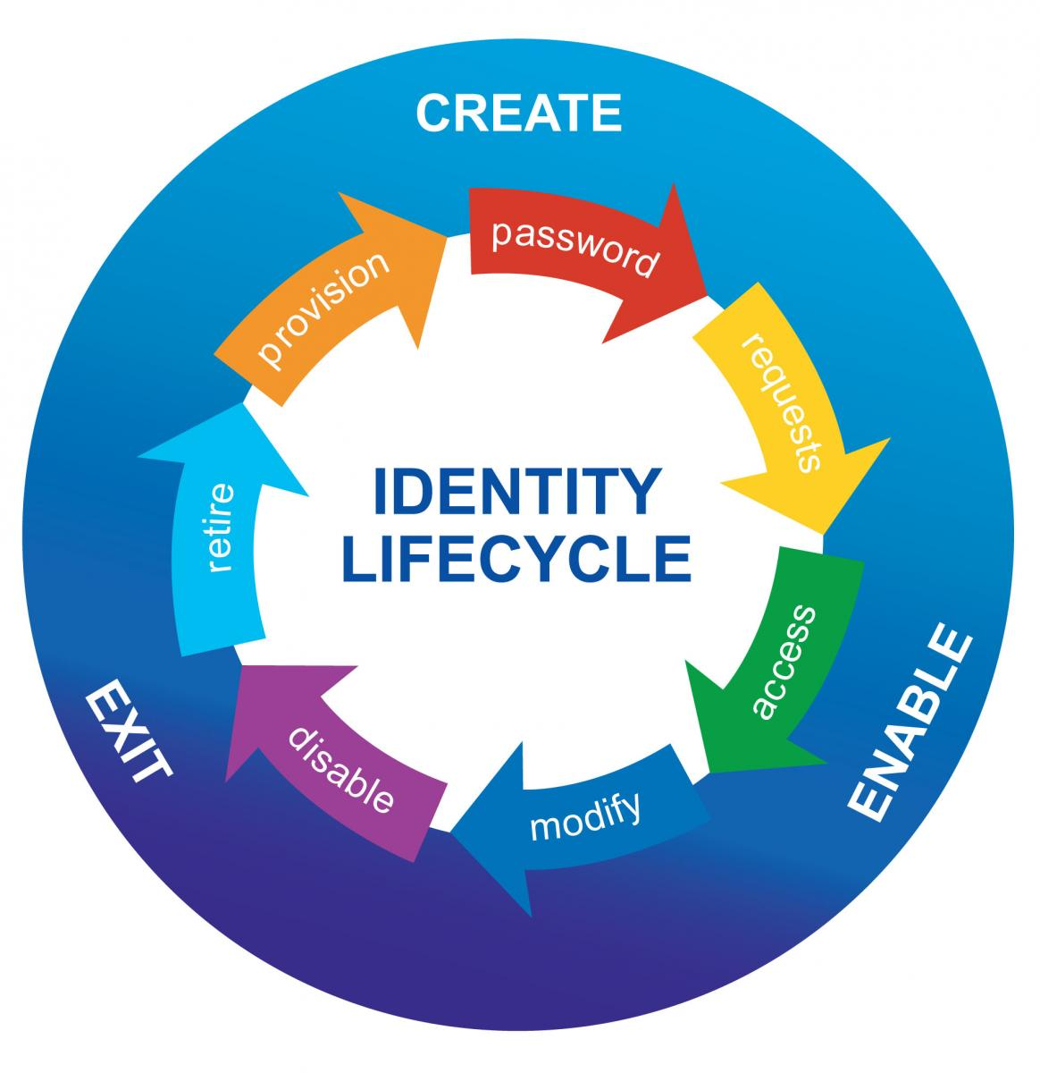
Identity & Identity Lifecycle
What is Identity?
A digital identity is the body of information about an individual, organization or electronic device that exists online.

Slide 4
Identity Governance & Administration Components
Workflow Management
Entitlement Management
Identity Lifecycle Management
Access Request
Access Certification
Auditing
Reporting & Analytics

Slide 5
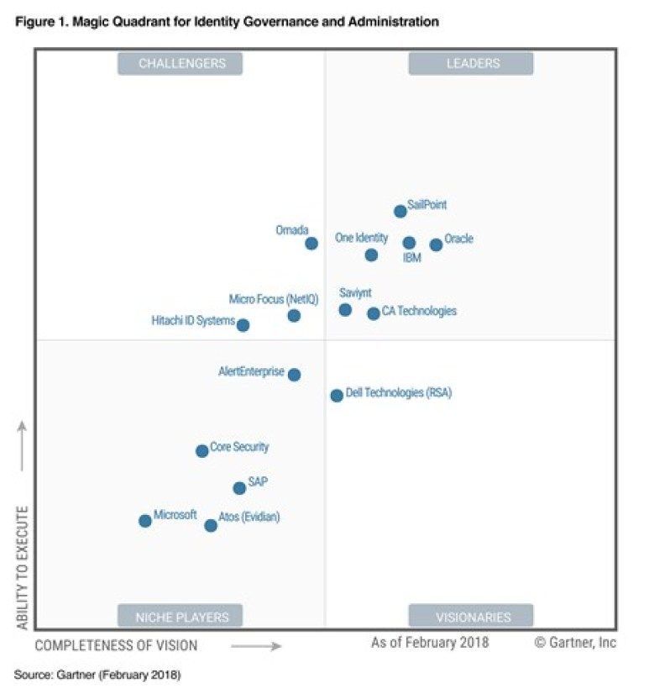
Introduction to Sailpoint IdentityIQ

Slide 6
Sailpoint IIQ Rule
Other types of Rule
Certification Rule
Notification/Assignment Rule
Identity and Account Mapping Rule
What is Rule?
Types of Rule?
Connector Rule
PreIterate Rule
Buildmap Rule
Aggregation/Refresh Rule
Correlation Rule
IdentityCreation Rule
ManagerCorrelation Rule
Provisioning Rule
BeforeProvisioning Rule
AfterProvisioning Rule
JDBCProvision Rule

Slide 7
Sailpoint IIQ Role
What is Entitlement?
What is Role? Relationship with Entitlement
Types of Role
Organizational Role
Business Role
IT Role
Entitlement
Role based provisioning

Slide 8
Sailpoint IIQ Role Based Provisioning
What is Provisioning?
What is Role Based Provisioning?
JDBC Connector App
Provisioning Policy
Provisioning Rule
Implement Role Based Provisioning

Slide 9
Sailpoint IIQ Deployment Accelerator
A plugin for the popular and free IDE Eclipse that provides several features designed to make configuring and managing IdentityIQ easier.
Benefits/Features:
Integration with multiple IdentityIQ environments (Dev, Test, QA, etc.)
Direct deployment, with token substitution, into any connected environment
Direct export/extract, with token replacement, from any connected environment
Steps:
Install plug-in to Eclipse
http://sailpoint.github.io/epiiq
Configure the server side workflow
https://sailpoint.github.io/epiiq/Workflow-Importer.xml
Create IIQ Project
Importing Objects from an IdentityIQ System
Deploying objects into an IdentityIQ System

